Slide 1
New Ideas Below

Slide 2


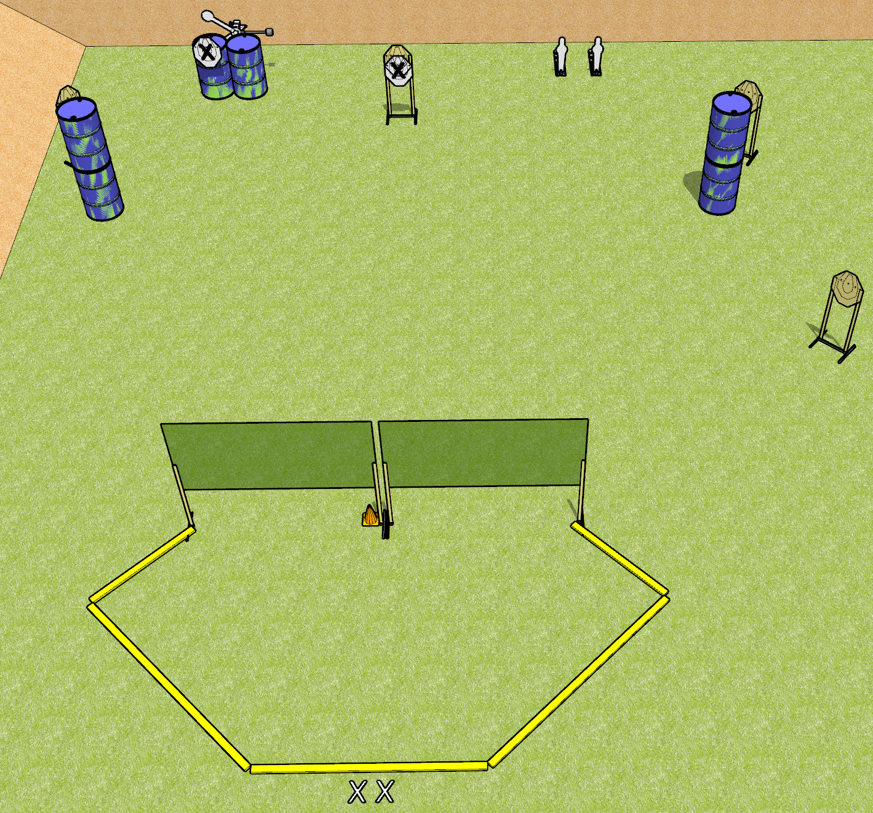
 | Dothan Gun Club – USPSA Match I Need Stitches Course Designer : Drew Coleman
START POSITION : Standing with both feet on X’s, wrists below belt
GUN READY CONDITION : Pistol loaded and holstered. PCC loaded, shouldered, safety on, pointed at orange cone. |  | SCORING: Comstock, 12 rounds TARGETS: 4 paper, 4 Steel SCORED HITS: Best 2 on paper, steel until down START-STOP: Audible, last shot RULES:
STAGE PROCEDURE: Engage targets as they become available from within the fault lines. Perform a mandatory reload before the last shot fired

Slide 3
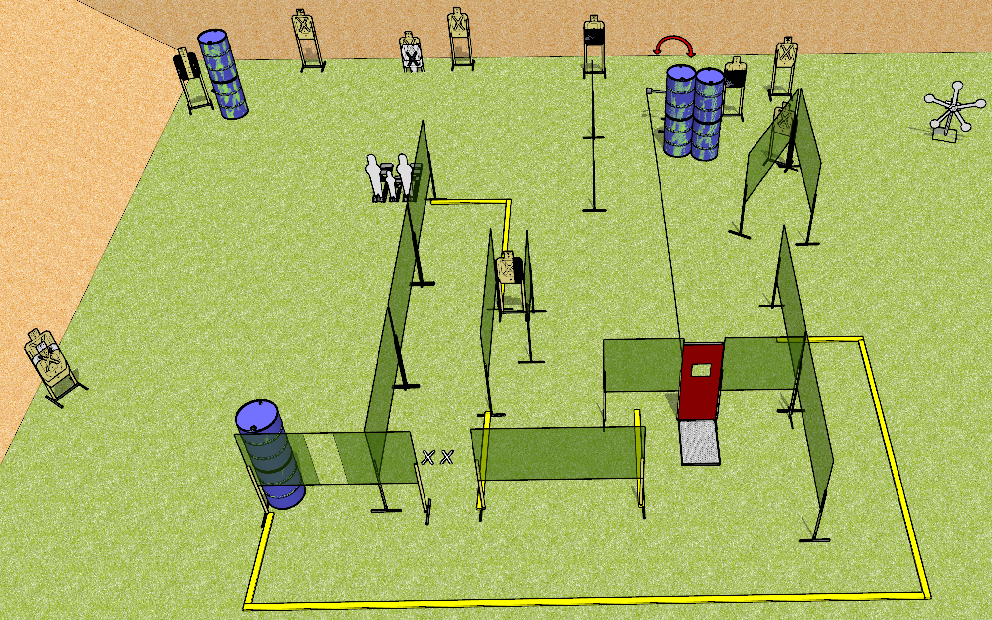
 | Dothan Gun Club – USPSA Match Don’t Mess With Me Course Designer : Drew Coleman
START POSITION : Standing with both feet on X’s, wrists below belt
GUN READY CONDITION : Pistol loaded and holstered. PCC loaded, shouldered, safety on, pointed at orange cone. |  | SCORING: Comstock, 34 rounds TARGETS: 14 paper, 8 Steel SCORED HITS: Best 2 on paper, steel until down START-STOP: Audible, last shot RULES:
STAGE PROCEDURE: Engage targets as they become available from within the fault lines.

Slide 4
Open target

Slide 5
Stuff you liked and I tweaked

Slide 6
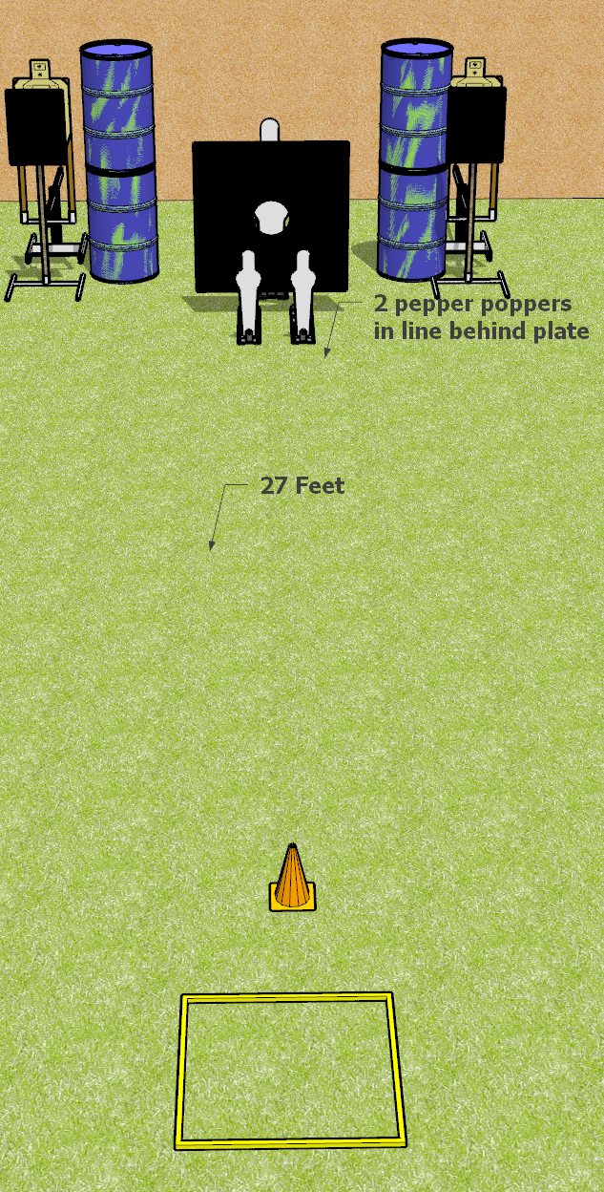
 | Dothan Gun Club – USPSA Match Be Quick Course Designer : Drew Coleman
START POSITION : Standing in shooting box, wrists below belt
GUN READY CONDITION : Pistol loaded and holstered. PCC loaded, shouldered, safety on, pointed at orange cone. |  | SCORING: Comstock, 8 rounds TARGETS: 2 paper, 4Steel SCORED HITS: Best 2 on paper, steel until down START-STOP: Audible, last shot RULES:
STAGE PROCEDURE: Engage targets as they become available from within the fault lines.

Slide 7
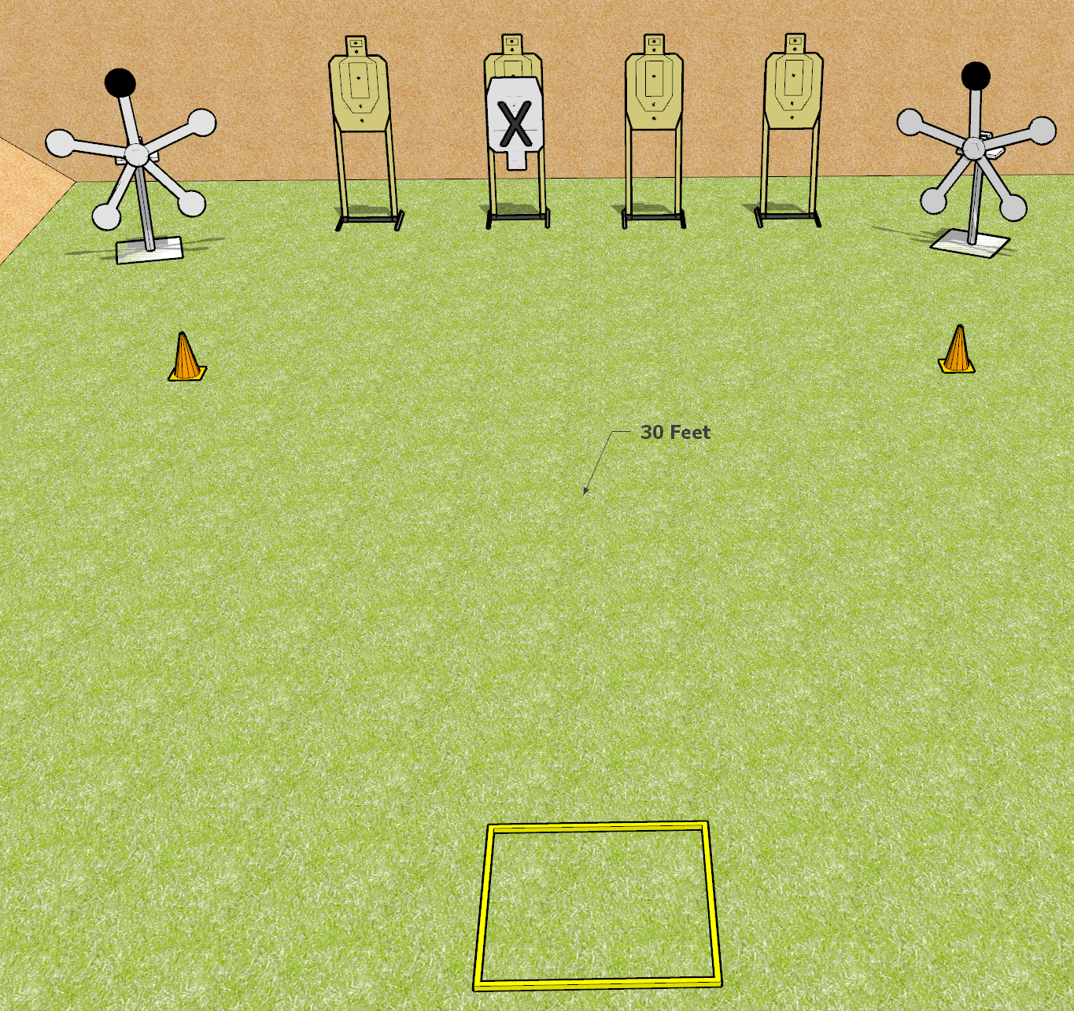
 | Dothan Gun Club – USPSA Match Seeing Stars Course Designer : Drew Coleman
START POSITION : Standing in shooting box, wrists above shoulders
GUN READY CONDITION : Pistol loaded and holstered. PCC loaded, shouldered, safety on, pointed at either orange cone. |  | SCORING: Comstock, 16 rounds TARGETS: 4 paper, 8 Steel SCORED HITS: Best 2 on paper, steel until down START-STOP: Audible, last shot RULES:
STAGE PROCEDURE: Engage either the paper or the steel, then perform a mandatory reload and engage the remaining array.

Slide 8
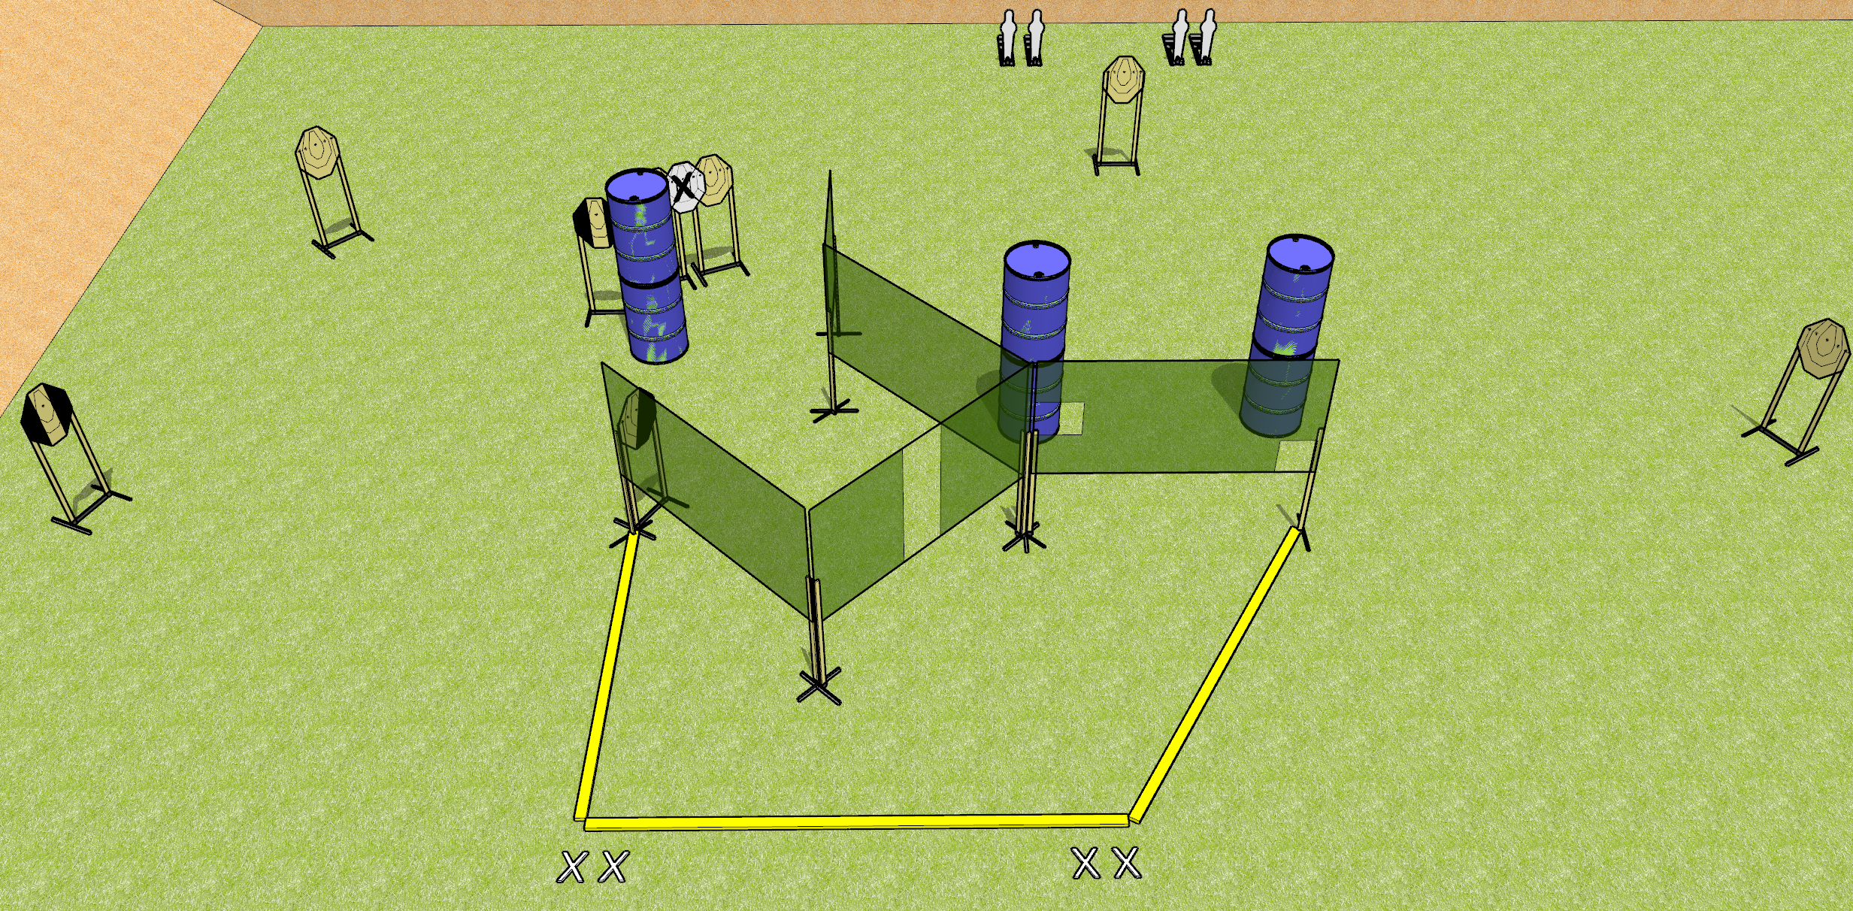

 | Dothan Gun Club – USPSA Match Punch Buggy Redux Course Designer : Drew Coleman
START POSITION : Standing with both feet on X’s, wrists above shoulders
GUN READY CONDITION : Pistol loaded and holstered. PCC loaded, buttstock on belt, safety on, pointed in a safe direction |  | SCORING: Comstock, 20 rounds TARGETS: 8 paper, 4 Steel SCORED HITS: Best 2 on paper, steel until down START-STOP: Audible, last shot RULES:
STAGE PROCEDURE: Engage targets as they become available from within the fault lines.

Slide 9
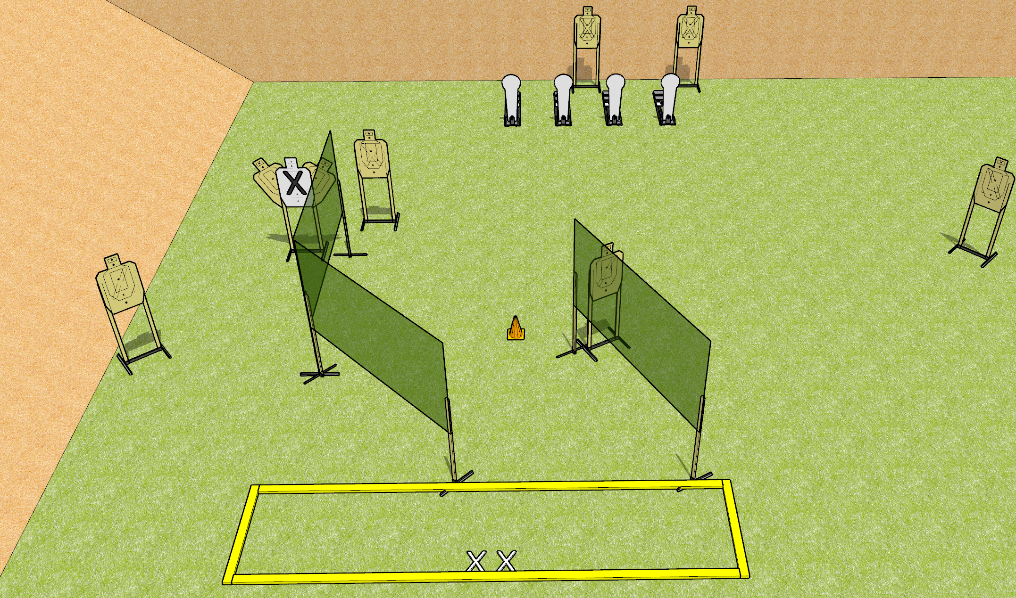
 | Dothan Gun Club – USPSA Match What Was I Thinking? Course Designer : Drew Coleman
START POSITION : Standing with both feet on X’s, wrists below belt
GUN READY CONDITION : Pistol loaded and holstered. PCC loaded, shouldered, safety on, pointed at orange cone. |  | SCORING: Comstock, 20 rounds TARGETS: 8 paper, 4 Steel SCORED HITS: Best 2 on paper, steel until down START-STOP: Audible, last shot RULES:
STAGE PROCEDURE: Engage targets as they become available from within the fault lines.

Slide 10
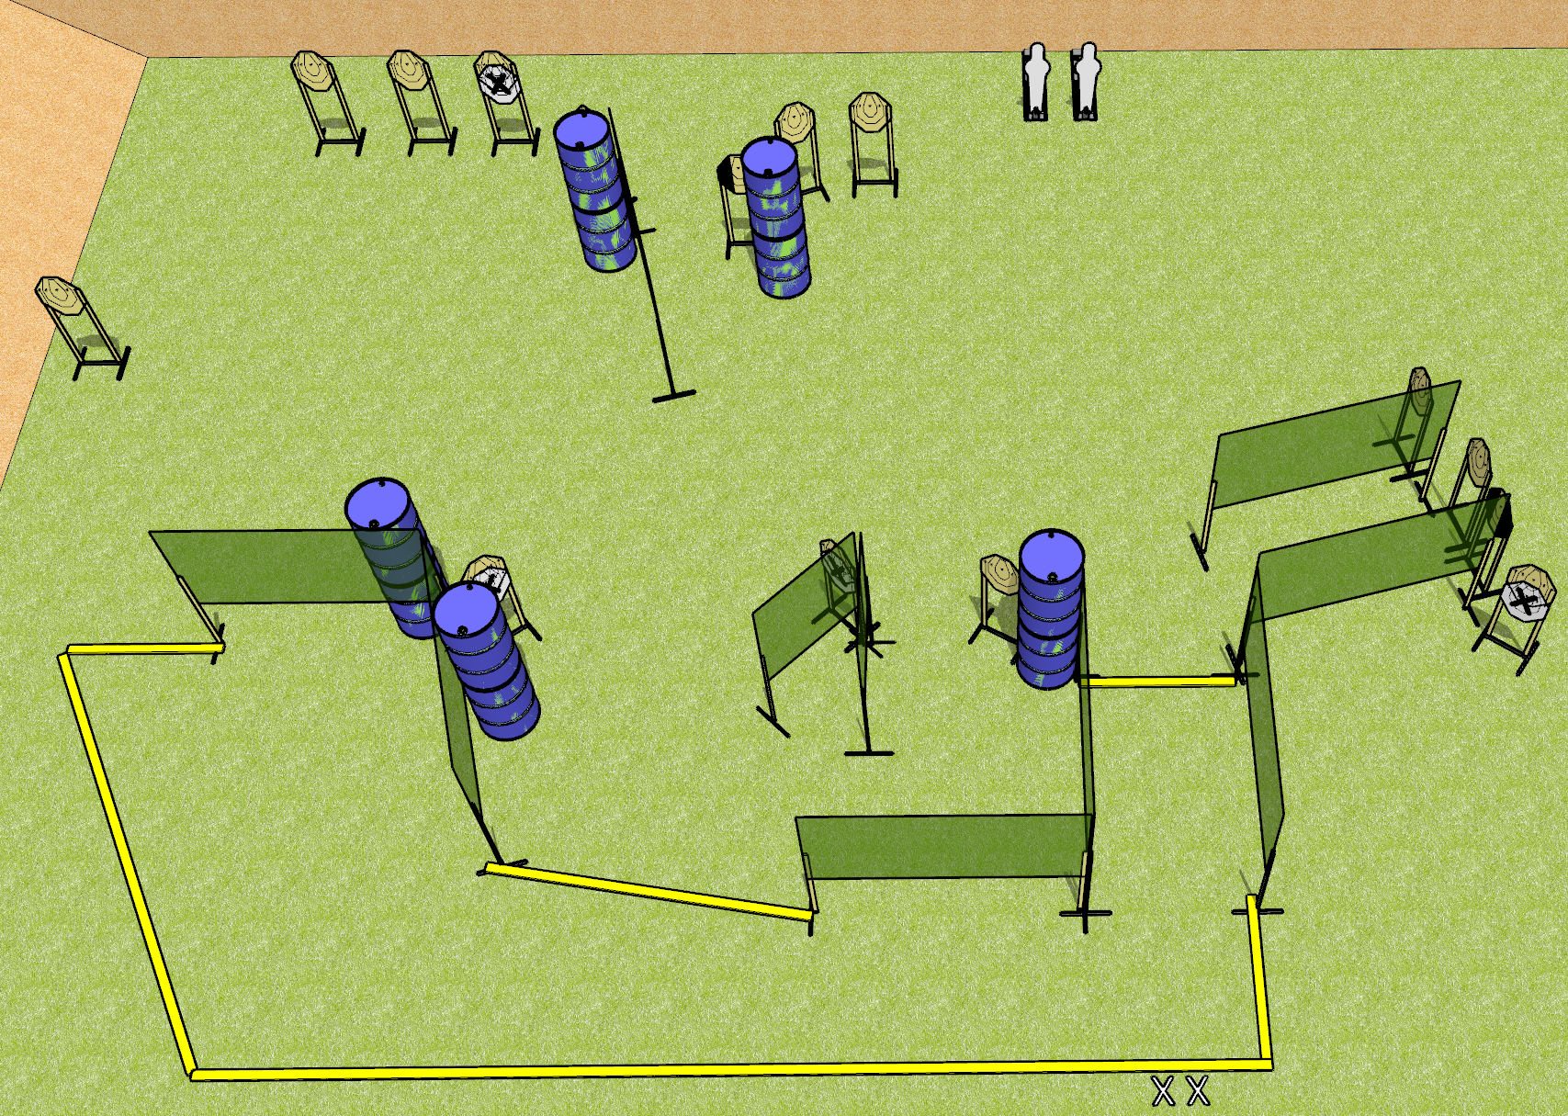
 | Dothan Gun Club – USPSA Match Gotta Move Course Designer : Drew Coleman
START POSITION : Standing with both feet on X’s, wrists below belt
GUN READY CONDITION : Pistol unloaded and holstered. PCC unloaded, buttstock on belt, pointed downrange. |  | SCORING: Comstock, 32 rounds TARGETS: 15 paper, 2 Steel SCORED HITS: Best 2 on paper, steel until down START-STOP: Audible, last shot RULES:
STAGE PROCEDURE: Engage targets as they become available from within the fault lines.

Slide 11
Vampire Target

Slide 12
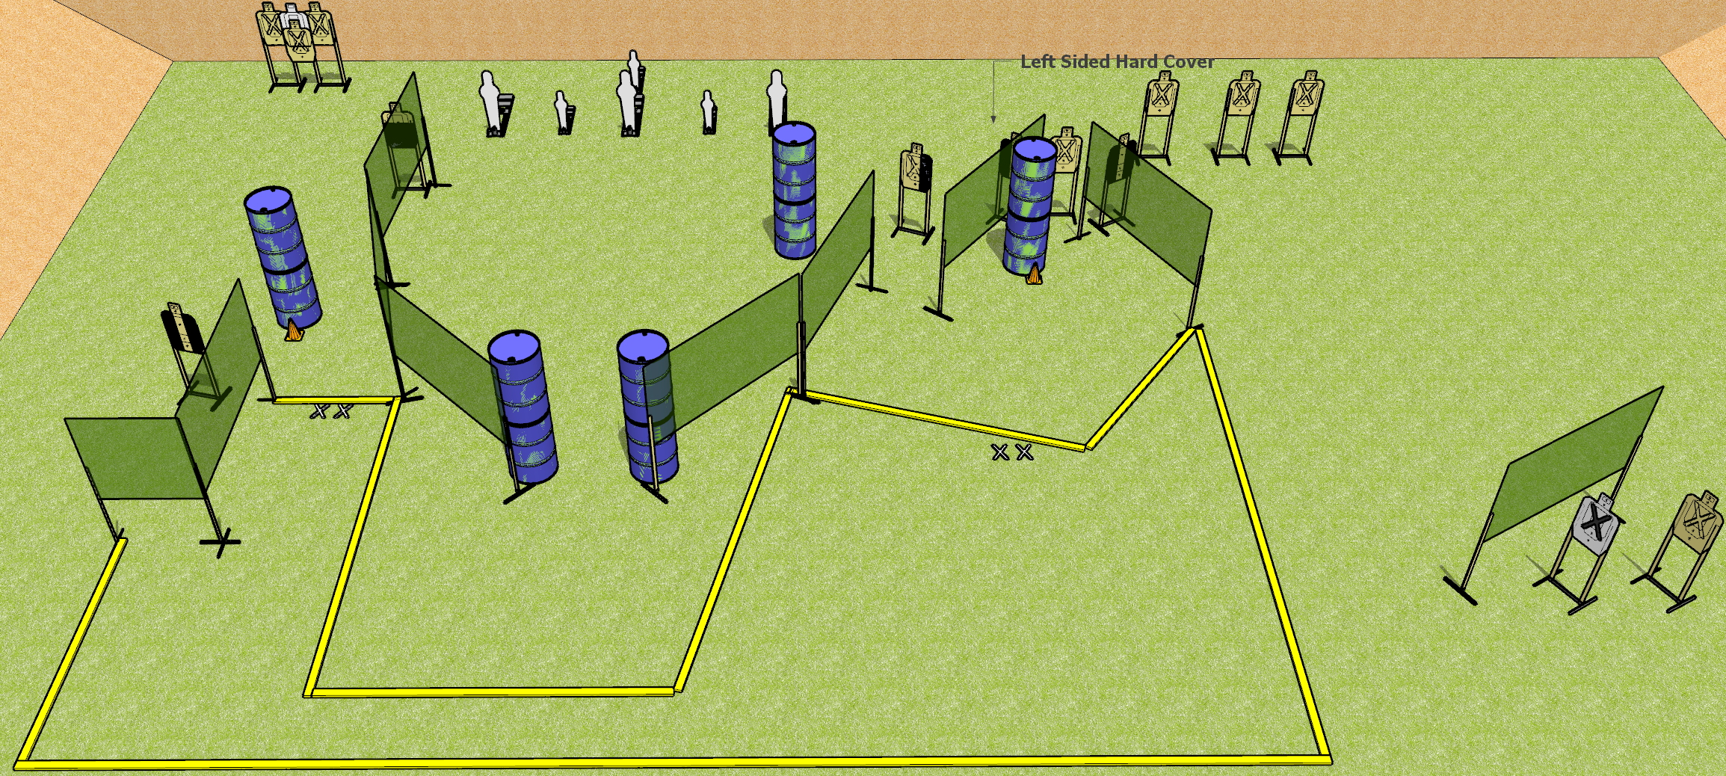
 | Dothan Gun Club – USPSA Match But Where? Course Designer : Drew Coleman
START POSITION : Standing with both feet on either set of X’s, wrists below belt
GUN READY CONDITION : Pistol loaded and holstered. PCC loaded, shouldered, safety on, pointed at either orange cone. |  | SCORING: Comstock, 32 rounds TARGETS: 13 paper, 6 Steel SCORED HITS: Best 2 on paper, steel until down START-STOP: Audible, last shot RULES:
STAGE PROCEDURE: Engage targets as they become available from within the fault lines.

Slide 13
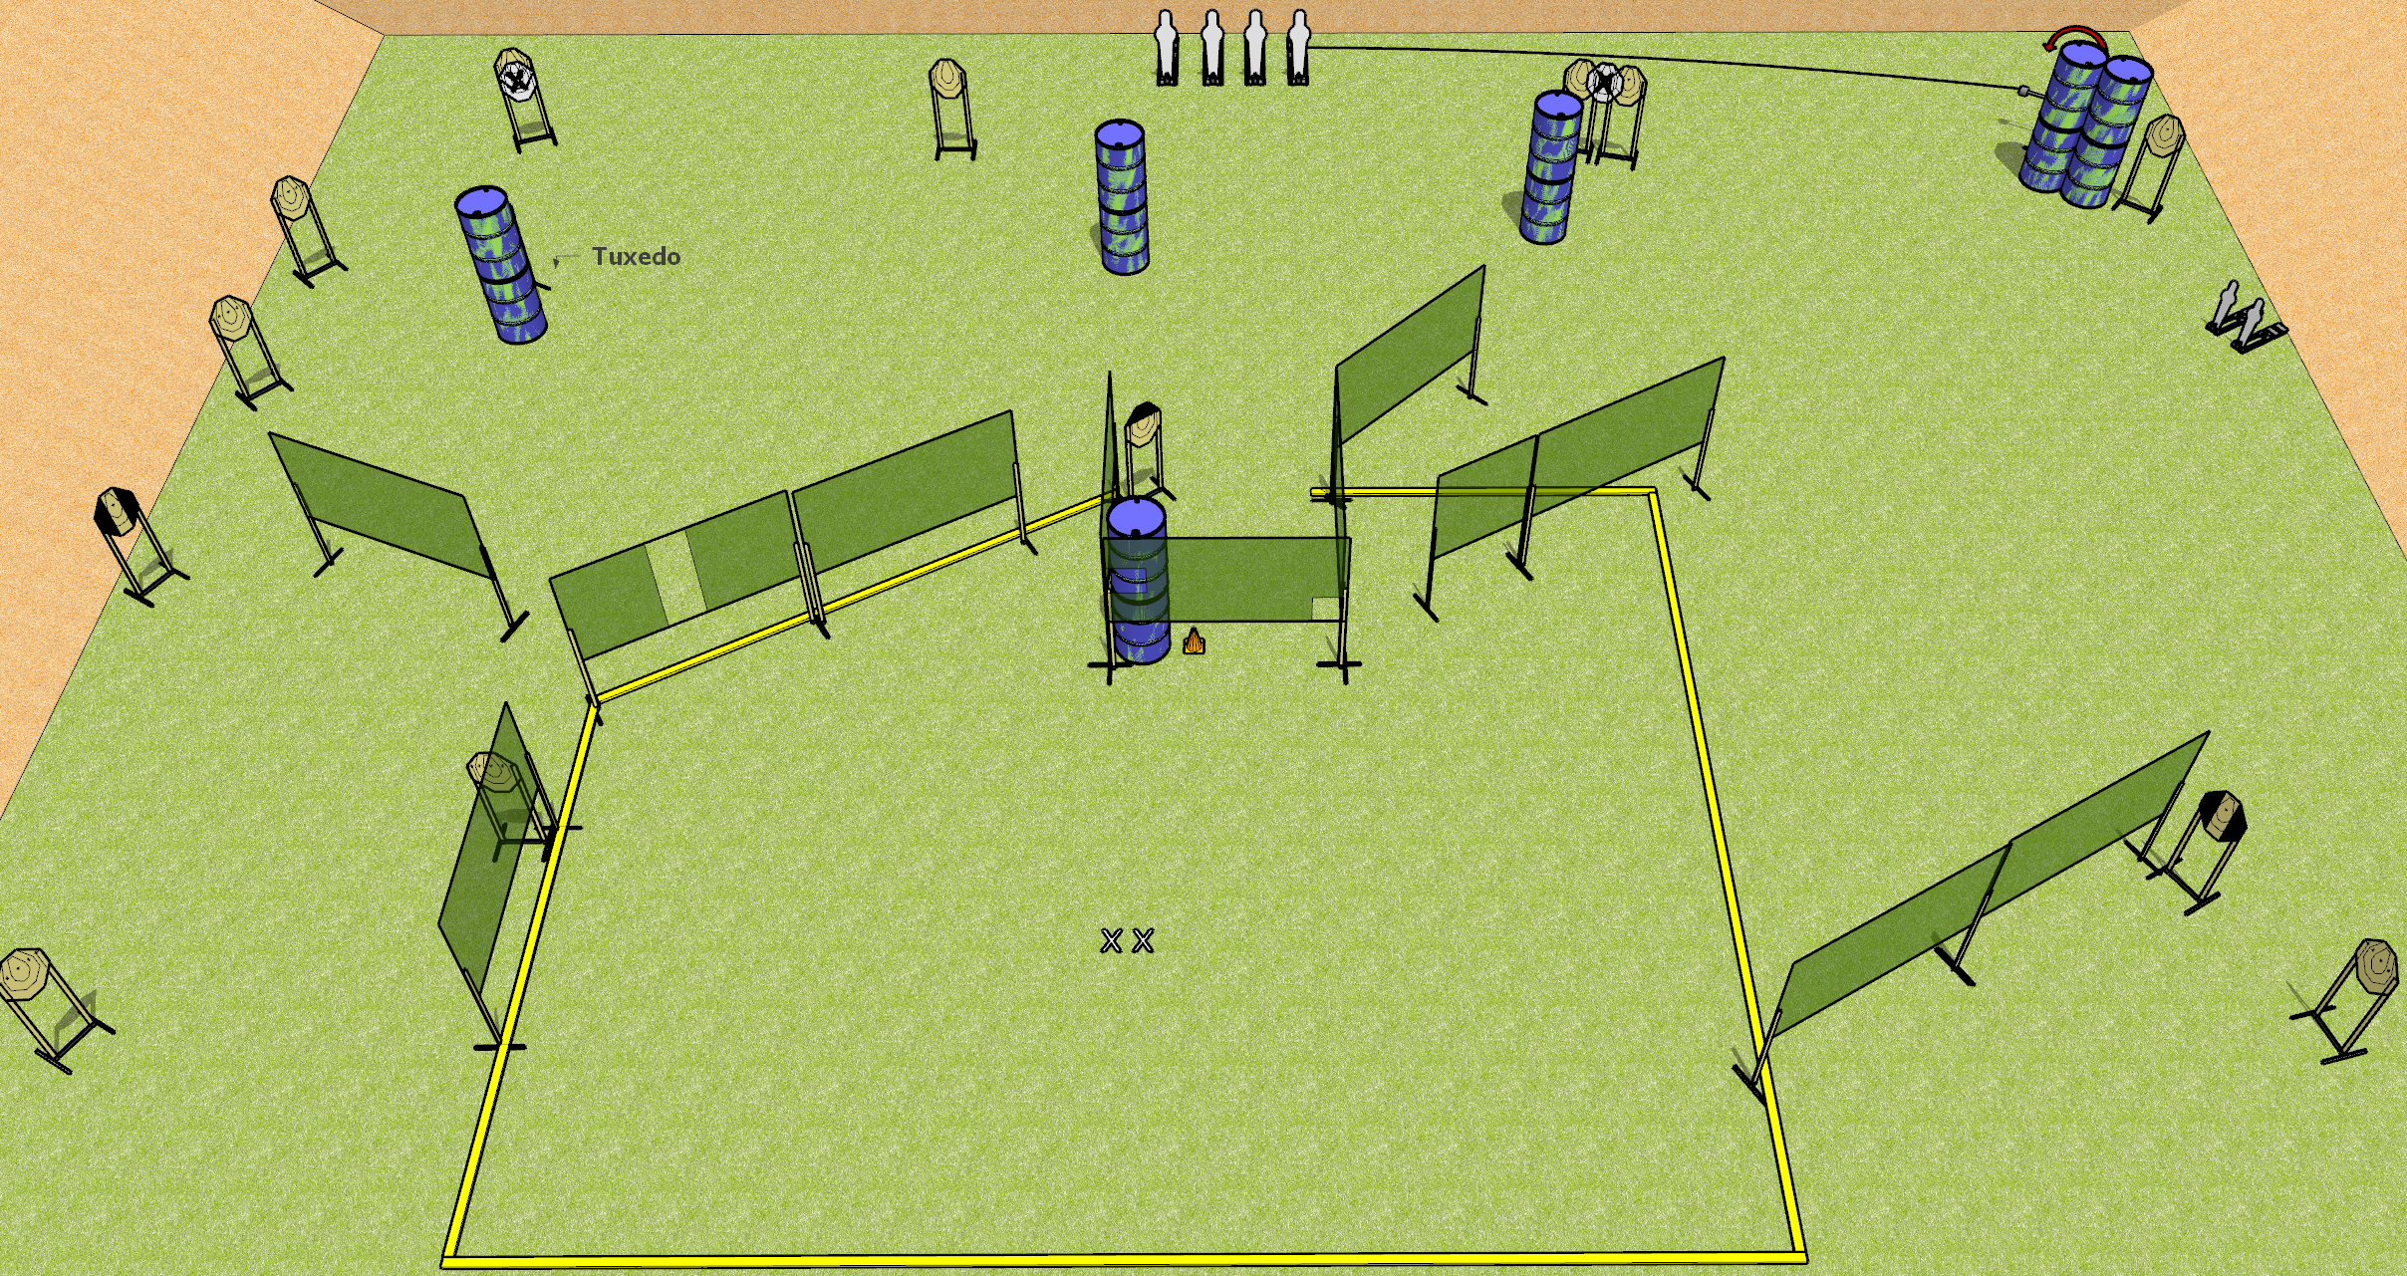
 | Dothan Gun Club – USPSA Match Gripes and Mikes Course Designer : Drew Coleman
START POSITION : Standing with both feet on X’s, wrists below belt
GUN READY CONDITION : Pistol loaded and holstered. PCC loaded, shouldered, safety on, pointed at orange cone. |  | SCORING: Comstock, 36 rounds TARGETS: 15 paper, 6 Steel SCORED HITS: Best 2 on paper, steel until down START-STOP: Audible, last shot RULES:
STAGE PROCEDURE: Engage targets as they become available from within the fault lines.

